Slide 1
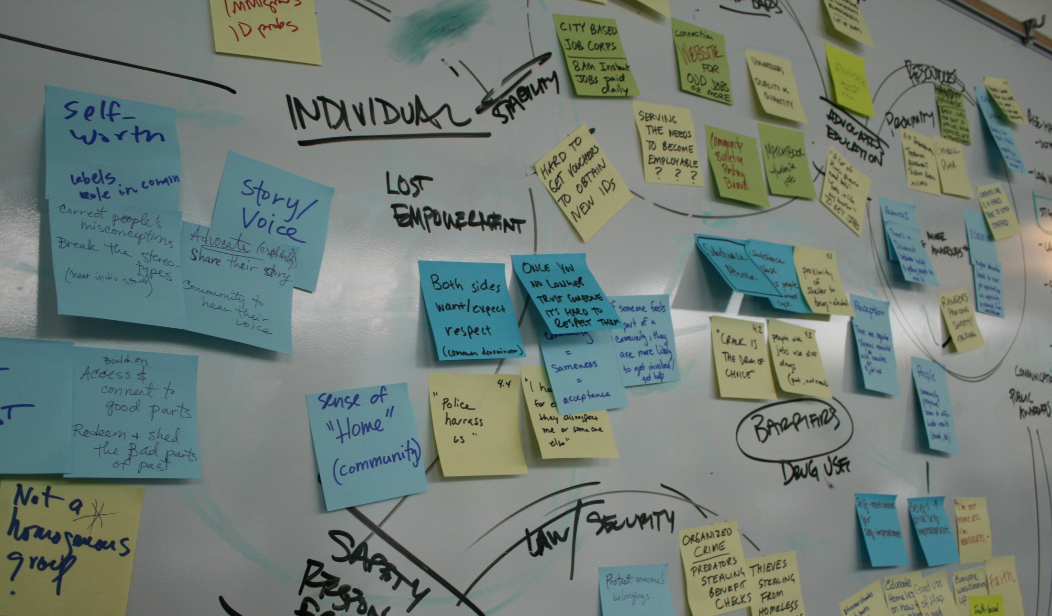
Affinity Diagramming
Jon Kolko Professor, Austin Center for Design

Slide 2
Ethnography
Synthesis
Prototyping
Making meaning through abductive sensemaking and reframing
Combining data in new ways
Identifying patterns and anomalies
Judging, and learning

Slide 3
Affinity Diagramming
A bottom-up process of organizing ideas by similarity, through grouping.
Notes:
3

Slide 4
Affinity Diagramming
A bottom-up process of organizing ideas by similarity, through grouping.
Notes:
4

Slide 5
Affinity Diagramming
A bottom-up process of organizing ideas by similarity, through grouping.
Notes:
5

Slide 6
Affinity Diagramming
A bottom-up process of organizing ideas by similarity, through grouping.
Notes:
6

Slide 7
Affinity Diagramming
A bottom-up process of organizing ideas by similarity, through grouping.
AFFINITY DIAGRAMMING/
Requires a large amount of time to create
Requires interpretation, where meaning is assigned to the data.
Organizes ideas into groups.
Allows for prioritization of ideas based on frequency.
Can be conducted by groups or individuals.
Can be used for organizing ideas, sentences, words, pictures, or any other data type.
Notes:
7

Slide 8
Mayonnaise
Lettuce
Deli
Potato Chips
Earl of Sandwich
Sourdough
Pickles
Ham
Cheese
Baguette
Rye
Roll
Here, or to go?
Fat Content
Pumpernickel
Bagel
Swiss
Avacado
Cheddar
BLT
Plate
Toaster
Panini Press
Sub
Notes:
8

Slide 9
“Sometimes, I put the mayo on both sides of the bread.”
“I don’t really believe that there was an Earl. It’s folklore.”
“I cook it until the cheese melts. That’s the key.”
“I don’t like multiple meats on my sandwiches.”
“Some people call it a sammy.”
“Sometimes, BBQ sauce tastes good.”
Notes:
9

Slide 10
Mayonnaise
“Some people call it a sammy.”
“I don’t really believe that there was an Earl. It’s folklore.”
“Sometimes, BBQ sauce tastes good.”
“Sometimes, I put the mayo on both sides of the bread.”
Lettuce
Earl of Sandwich
Pickles
Avacado
Cheese
Ham
“I don’t like multiple meats on my sandwiches.”
Baguette
Pumpernickel
Swiss
BLT
Bagel
Cheddar
Roll
Rye
Sub
Sourdough
Here, or to go?
“I cook it until the cheese melts. That’s the key.”
Potato Chips
Toaster
Plate
Deli
Panini Press
Notes:
10

Slide 11
“Some people call it a sammy.”
Mayonnaise
Sandwich folklore
“I don’t really believe that there was an Earl. It’s folklore.”
“Sometimes, BBQ sauce tastes good.”
“Sometimes, I put the mayo on both sides of the bread.”
Lettuce
Things you put on sandwiches
Earl of Sandwich
Pickles
Avacado
Cheese
Ham
“I don’t like multiple meats on my sandwiches.”
Baguette
Pumpernickel
Swiss
BLT
Bagel
Types of bread
Cheddar
Roll
Rye
Sub
Sourdough
Purchasing a sandwich
Here, or to go?
“I cook it until the cheese melts. That’s the key.”
Potato Chips
Cooking a sandwich
Toaster
Plate
Deli
Panini Press
Notes:
11

Slide 12
Affinity Diagramming
A bottom-up process of organizing ideas by similarity, through grouping.
AFFINITY DIAGRAMMING/
Requires a large amount of time to create
Requires interpretation, where meaning is assigned to the data.
Organizes ideas into groups.
Allows for prioritization of ideas based on frequency.
Can be conducted by groups or individuals.
Can be used for organizing ideas, sentences, words, pictures, or any other data type.
HOW TO DO IT/
Identify each idea, and place it on a single, movable tile (post-it, 8.5x11 paper, etc)
Move the ideas around, and identify relationships through a bottom-up process
When groupings start to emerge, give them labels.
When groupings get too big (8+ items), split them into smaller groupings.
Notes:
12

