Slide 1
Concept Mapping
Jon Kolko Professor, Austin Center for Design

Slide 2
Concept Map
A representation of a system that sacrifices accuracy for comprehensibility; a tool for sensemaking.
Notes:
2

Slide 3
Concept Map
A representation of a system that sacrifices accuracy for comprehensibility; a tool for sensemaking.
A CONCEPT MAP/
Visualizes both the forest and the trees
Rarely has a “beginning” and “end”
Helps people find their way
Provides direction and instruction
Forces selectivity, abstraction, prioritization and hierarchy
Is visual (a tool for perception)
Is semantic (a tool for cognition)
Represents the user’s mental model of a how a system might work
Can also represent the designer’s manifest model of how a system might appear
Notes:
3

Slide 4
Concept Map
We’ll use a concept map to understand the organization and boundaries of a complex system.
Think of it as a translation between words and visuals – a way of jumping from a set of written requirements to an initial design schema.
Notes:
4

Slide 5
For Example…
Baseball
is a
is played on a
2-Team Sport
supervised by
played in nine sections called
played by
Offensive Team
Defensive Team
Innings
Infield
consists of
consists of
Runner
Catcher
Left Fielder
Short Stop
1st Baseman
Pitcher
stands on
Mound
Home Plate
Right Fielder
2nd Baseman
Center Fielder
3rd Baseman
throws

Slide 6
For Example…
Nodes (nouns) are main branches
Baseball
is a
is played on a
2-Team Sport
supervised by
played in nine sections called
played by
Offensive Team
Defensive Team
Innings
Infield
consists of
consists of
Runner
Catcher
Left Fielder
Short Stop
1st Baseman
Pitcher
stands on
Mound
Home Plate
Right Fielder
2nd Baseman
Center Fielder
3rd Baseman
throws

Slide 7
For Example…
Actions (verbs) link the nodes
Baseball
is a
is played on a
2-Team Sport
supervised by
played in nine sections called
played by
Offensive Team
Defensive Team
Innings
Infield
consists of
consists of
Runner
Catcher
Left Fielder
Short Stop
1st Baseman
Pitcher
stands on
Mound
Home Plate
Right Fielder
2nd Baseman
Center Fielder
3rd Baseman
throws

Slide 8
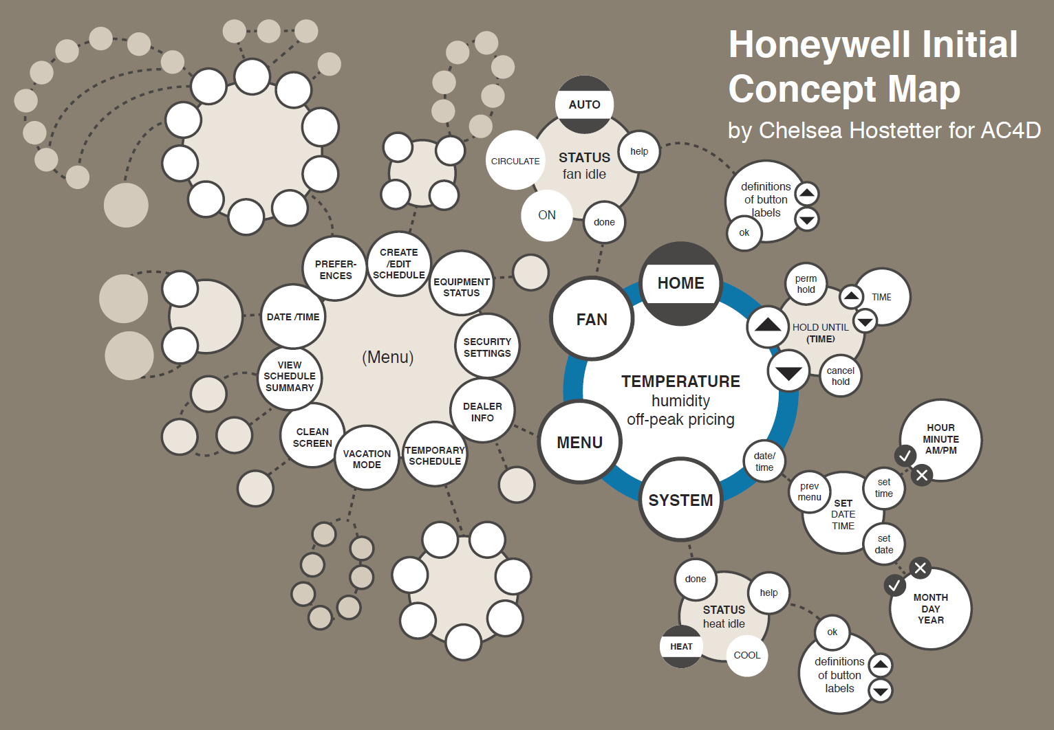

Slide 9
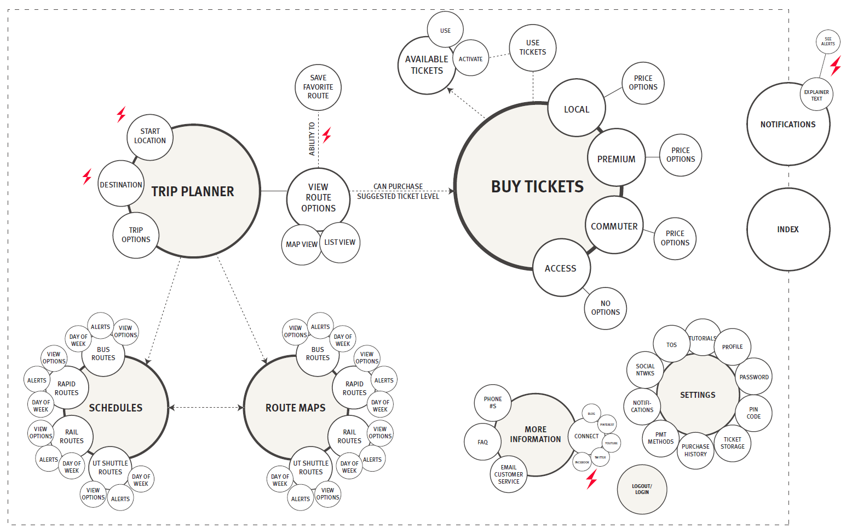

Slide 10
Creating a Concept Map
Create a matrix showing the relations of terms
List terms. Identify the main elements that make up the system; lean on your contextual research to understand the words that matter to the users the most.
Create empty matrix, plotting the words against themselves.
Identify relationships; these are qualitative and require interpretation.

Slide 11
Creating a Concept Map
Identify the main branches of the map.
Use frequency of connections, as well as common sense. Create the backbone or structure of the map so that it makes a cohesive sentence.

Slide 12
Creating a Concept Map
Fill in the rest of the structure
Be sure to represent all of the elements in the system.

Slide 13
Creating a Concept Map
Enhance with visual design
Use visual design to clarify and make the content more accessible .

Slide 14
For example…
Making a concept map of AC4D.
Social Entrepreneurship
Autonomous
Confidence
Project
Management
Sketching
Branding
Roadmaps
Strategist
Behavior
Impact
Sarcasm
Visual Design
Creativity
Theory of Change
Jon Kolko
Wicked Problems
Fun
Beer
Whiteboards
Mobile

Slide 15
 | Soc. Ent | Autonomous | Confidence | Project Mgmt | Sketching | Branding | Roadmaps | Strategist | Behavior | Impact | Sarcasm | Visual Design | Creativity | Theory of Change | Jon Kolko | Wicked Problems | Fun | Beer | Whiteboards | Mobile
Soc. Ent
Autonomous
Confidence
Project Mgmt
Sketching
Branding
Roadmaps
Strategist
Behavior
Impact
Sarcasm
Visual Design
Creativity
Theory of Change
Jon Kolko
Wicked Problems
Fun
Beer
Whiteboards
Mobile

Slide 16
 | Soc. Ent | Autonomous | Confidence | Project Mgmt | Sketching | Branding | Roadmaps | Strategist | Behavior | Impact | Sarcasm | Visual Design | Creativity | Theory of Change | Jon Kolko | Wicked Problems | Fun | Beer | Whiteboards | Mobile
Soc. Ent
Autonomous
Confidence
Project Mgmt
Sketching
Branding
Roadmaps
Strategist
Behavior
Impact
Sarcasm
Visual Design
Creativity
Theory of Change
Jon Kolko
Wicked Problems
Fun
Beer
Whiteboards
Mobile

Slide 17
 | Soc. Ent | Autonomous | Confidence | Project Mgmt | Sketching | Branding | Roadmaps | Strategist | Behavior | Impact | Sarcasm | Visual Design | Creativity | Theory of Change | Jon Kolko | Wicked Problems | Fun | Beer | Whiteboards | Mobile
Soc. Ent
Autonomous
Confidence
Project Mgmt
Sketching
Branding
Roadmaps
Strategist
Behavior
Impact
Sarcasm
Visual Design
Creativity
Theory of Change
Jon Kolko
Wicked Problems
Fun
Beer
Whiteboards
Mobile

Slide 18
 | Soc. Ent | Autonomous | Confidence | Project Mgmt | Sketching | Branding | Roadmaps | Strategist | Behavior | Impact | Sarcasm | Visual Design | Creativity | Theory of Change | Jon Kolko | Wicked Problems | Fun | Beer | Whiteboards | Mobile
Soc. Ent
Autonomous
Confidence
Project Mgmt
Sketching
Branding
Roadmaps
Strategist
Behavior
Impact
Sarcasm
Visual Design
Creativity
Theory of Change
Jon Kolko
Wicked Problems
Fun
Beer
Whiteboards
Mobile

Slide 19
 | Soc. Ent | Autonomous | Confidence | Project Mgmt | Sketching | Branding | Roadmaps | Strategist | Behavior | Impact | Sarcasm | Visual Design | Creativity | Theory of Change | Jon Kolko | Wicked Problems | Fun | Beer | Whiteboards | Mobile
Soc. Ent
Autonomous
Confidence
Project Mgmt
Sketching
Branding
Roadmaps
Strategist
Behavior
Impact
Sarcasm
Visual Design
Creativity
Theory of Change
Jon Kolko
Wicked Problems
Fun
Beer
Whiteboards
Mobile

Slide 20
AC4D
teaches
Social Entrepreneurship
Where students become
Autonomous
To drive
Impact
In the context of
Wicked Problems

Slide 21
AC4D
Beer
Fun
Sarcasm
Visual
Design
teaches
Built through
Social Entrepreneurship
Project
Mgmt
Confidence
Which require
Where students become
Strategy
Autonomous
Using competencies like
Sketching
To drive
Roadmaps
Using methods like
Impact
Based on changing
Behavior
Theory of Change
In the context of
Wicked Problems

Slide 22
AC4D
Beer
Fun
Sarcasm
Visual
Design
teaches
Built through
Social Entrepreneurship
Project
Mgmt
Confidence
Which require
Where students become
Strategy
Autonomous
Using competencies like
Sketching
To drive
Roadmaps
Using methods like
Impact
Based on changing
Behavior
Theory of Change
In the context of
Wicked Problems

Slide 23
Concept Map, Recap
A representation of a system that sacrifices accuracy for comprehensibility; a tool for sensemaking.
A CONCEPT MAP/
Visualizes both the forest and the trees
Rarely has a “beginning” and “end”
Helps people find their way
Provides direction and instruction
Forces selectivity, abstraction, prioritization and hierarchy
Is visual (a tool for perception)
Is semantic (a tool for cognition)
Represents the user’s mental model of a how a system might work
Can also represent the designer’s manifest model of how a system might appear
HOW TO MAKE IT/
Create a matrix showing the relations of terms
Identify the main branches of the map
Fill in the rest of the structure
Enhance with visual design
Notes:
23

