Slide 1
Design Synthesis
Jon Kolko Professor, Austin Center for Design

Slide 2
Well-Structured Problems
Ill- Structured Problems
Wicked Problems

Slide 3
Well-Structured Problems
Ill- Structured Problems
Wicked Problems
In a well structured problem, all of these are true:
We can test our solution. We can identify problem, goal, and interim states. We can identify solution steps. We can identify domain knowledge. We can solve the problem while obeying the laws of nature. We can solve the problem using only practical levels of effort.
Herb Simon, 1973

Slide 4
Well-Structured Problems
Ill- Structured Problems
Wicked Problems
In an ill-structured problem, some of these are true:
We cannot test our solution, or cannot test it easily. We cannot easily identify problem, goal, or interim states. We cannot identify all of the solution steps. We cannot identify domain knowledge (it may be tacit). We may be constrained by the laws of nature. Solutioning may outweigh practical efforts.
Herb Simon, 1973

Slide 5
Well-Structured Problems
Ill- Structured Problems
Wicked Problems
In a wicked problem, the following are true:
Wicked problems have no definitive formulation.
Wicked problems have no criteria upon which to determine “solving”.
Solutions to wicked problems can only be good or bad.
There are no complete list of applicable "moves" for a solution.
There are always more than one explanation for a wicked problem.
Every wicked problem is a symptom of another problem.
No solution of a wicked problem has a definitive, scientific test.
Every wicked problem is unique.
Horst Rittel, 1973

Slide 6
Well-Structured Problems
Ill- Structured Problems
Wicked Problems
*
*
*
*
*
Designers solve problems using a process.
Design Synthesis is the magical part of the process.
*
*
*
*
*
*
*
*
*
*
*
*
*
*
*
*

Slide 7
Ethnography
Synthesis
Prototyping
Notes:
7

Slide 8
Ethnography
Synthesis
Prototyping
Immersion – gathering data and understanding of a unique situation
Notes:
8

Slide 9
Ethnography
Synthesis
Prototyping
Immersion – gathering data and understanding of a unique situation
Hypothesis validation through generative form giving
Notes:
9

Slide 10
Ethnography
Synthesis
Prototyping
Immersion – gathering data and understanding of a unique situation
Hypothesis validation through generative form giving
Synthesis is the process of making meaning through inference-based sensemaking.
Notes:
10

Slide 11
Ethnography
Synthesis
Prototyping
Synthesis is the process of making meaning through inference-based sensemaking.
Notes:
11

Slide 12
deductive
inductive
abductive
Notes:
12

Slide 13
Jon is a Designer.
All Designers are Arrogant Bastards.
Therefore, Jon is an Arrogant Bastard.
deductive
inductive
abductive
The output is guaranteed to be true, if the premise is true.
Notes:
13

Slide 14
All of the designers I’ve ever seen wear black t-shirts.
Therefore, the next designer I will see will be wearing a black t-shirt.
Jon is a Designer.
All Designers are Arrogant Bastards.
Therefore, Jon is an Arrogant Bastard.
deductive
inductive
abductive
The output is guaranteed to be true, if the premise is true.
Gives good evidence that a conclusion is true.
Notes:
14

Slide 15
All of the designers I’ve ever seen wear black t-shirts.
Therefore, the next designer I will see will be wearing a black t-shirt.
When a designer works on a project, they often draw diagrams of things. It seems to help them learn about a new topic.
I’ve seen grade school students struggle to learn complex topics of math or science.
I can abduct that students might be able to learn better by drawing diagrams in a classroom setting.
Jon is a Designer.
All Designers are Arrogant Bastards.
Therefore, Jon is an Arrogant Bastard.
deductive
inductive
abductive
The output is guaranteed to be true, if the premise is true.
Gives good evidence that a conclusion is true.
The argument from best explanation, depending on circumstances and experience – an inference.
Notes:
15

Slide 16
Ethnography
Synthesis
Prototyping
Synthesis is the process of making meaning through inference-based sensemaking.
Notes:
16

Slide 17
Ethnography
Synthesis
Prototyping
Synthesis is the process of making meaning through inference-based sensemaking.
Notes:
17

Slide 18
David Snowden
“We have found that [our sensemaking framework] helps people to break out of old ways of thinking and to consider intractable problems in new ways… it is designed to allow shared understandings to emerge through the multiple discourses of the decision-making group.”

Slide 19
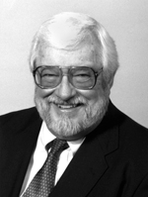
Karl Weick
“Sensemaking is, importantly, an issue of language, talk, and communication. Situations, organizations, and environments are talked into existence… Sensemaking is about the interplay of action and interpretation rather than the influence of evaluation on choice.”

Slide 20
Robert Hoffman
“By sensemaking, modern researchers seem to mean something different from creativity, comprehension, curiosity, mental modeling, explanation, or situational awareness... Sensemaking is a motivated, continuous effort to understand connections (which can be among people, places, and events) in order to anticipate their trajectories and act effectively.”

Slide 21
Ethnography
Synthesis
Prototyping
Synthesis is the process of making meaning through inference-based sensemaking.
Notes:
21

Slide 22
Ethnography
Synthesis
Prototyping
It’s a process of learning.
Notes:
22

Slide 23
Ethnography
Synthesis
Prototyping
Data
Information
Wisdom
Knowledge
?
?
?
Making Meaning out of Data
Experience Frameworking
Gaining
Empathy
Notes:
23

Slide 24
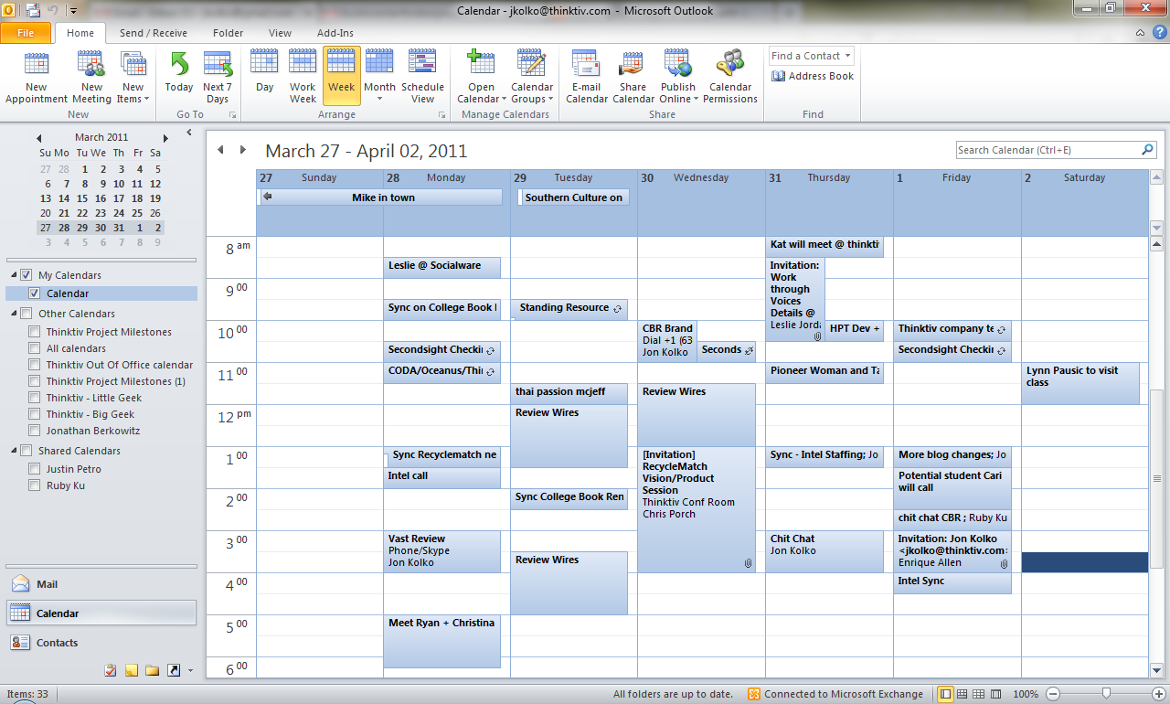
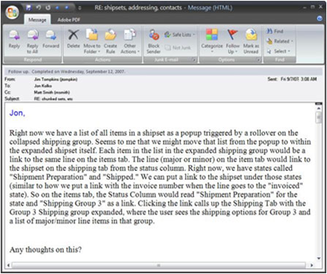
: (
“It would be great if this thing was a lot bigger”
“It’s too big, why can’t they just make it smaller?”
Data
Information
Wisdom
Knowledge
Notes:
24

Slide 25
Data
Information
Wisdom
Knowledge
Making Meaning out of Data
Experience Frameworking
Gaining
Empathy
Notes:
25

Slide 26
Data
Information
Wisdom
Knowledge
Making Meaning out of Data
Experience Frameworking
Gaining
Empathy
Notes:
26

Slide 27
Data
Information
Wisdom
Knowledge
Making Meaning out of Data
Experience Frameworking
Gaining
Empathy
1.
Externalize the Process – Get out of your laptop.
Notes:
27

Slide 28
Data
Information
Wisdom
Knowledge
Making Meaning out of Data
Experience Frameworking
Gaining
Empathy
2.
Make diagrams.
Notes:
28

Slide 29
Data
Information
Wisdom
Knowledge
Making Meaning out of Data
Experience Frameworking
Gaining
Empathy
3.
Interpret. Heavily.
Notes:
29

Slide 30
Data
Information
Wisdom
Knowledge
Making Meaning out of Data
Experience Frameworking
Gaining
Empathy
Methods:
affinity diagramming
hierarchy creation
flow diagramming
scenario development
Notes:
30

Slide 31
Data
Information
Wisdom
Knowledge
Making Meaning out of Data
Experience Frameworking
Gaining
Empathy
Notes:
31

Slide 32
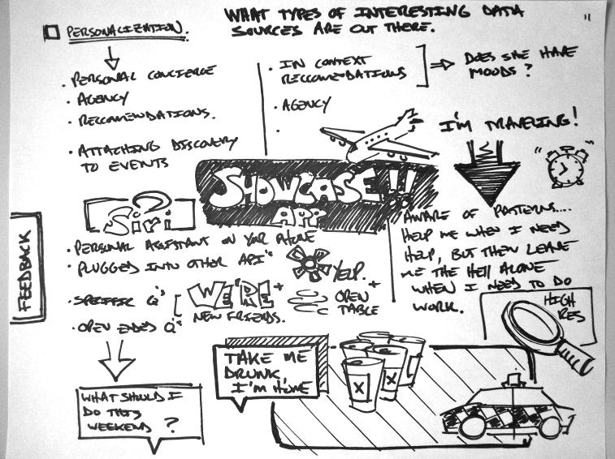
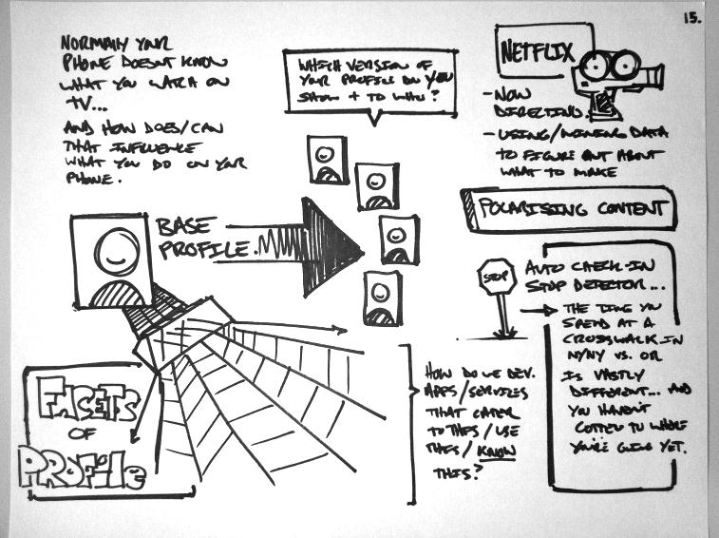
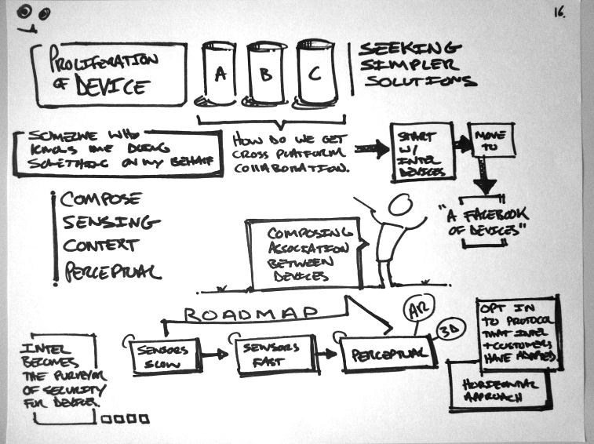
Data
Information
Wisdom
Knowledge
Making Meaning out of Data
Experience Frameworking
Gaining
Empathy
1.
Tell a story
Notes:
32

Slide 33
Data
Information
Wisdom
Knowledge
Making Meaning out of Data
Experience Frameworking
Gaining
Empathy
2.
Change your perspective
Warmth
Multisensory
Atmosphere and Culture
Sitting on a Comfy Couch
Comfortable Living Room
A Cup of Coffee
Freshly Ground Coffee
Grinder
Roasted Coffee Beans
Green Coffee Beans
Coffee Tree
Notes:
33

Slide 34
Data
Information
Wisdom
Knowledge
Making Meaning out of Data
Experience Frameworking
Gaining
Empathy
A product, becoming another product
3.
Shift the context
A product, being passed down to a new generation
A product, being upgraded
A product that doesn’t work
A product, being assembled
A product, being purchased
A product, being unpacked and set up
A product, being used
A product, becoming worn and loved
A product, becoming obsolete
A product, being discarded
A product accessory
A product, that was misplaced
Notes:
34

Slide 35
Data
Information
Wisdom
Knowledge
Making Meaning out of Data
Experience Frameworking
Gaining
Empathy
Methods:
concept mapping
temporal zoom
semantic zoom
storyboarding
process flow
customer journey mapping
Notes:
35

Slide 36
Data
Information
Wisdom
Knowledge
Making Meaning out of Data
Experience Frameworking
Gaining
Empathy
Notes:
36

Slide 37
Wisdom
Data
Information
Wisdom
Knowledge
Making Meaning out of Data
Experience Frameworking
Gaining
Empathy
1.
Consider a provocation
Notes:
37

Slide 38
Data
Information
Wisdom
Knowledge
Making Meaning out of Data
Experience Frameworking
Gaining
Empathy
2.
Force a constraint-shift
Notes:
38

Slide 39
Data
Information
Wisdom
Knowledge
Making Meaning out of Data
Experience Frameworking
Gaining
Empathy
3.
Walk a mile in their shoes
Notes:
39

Slide 40
Data
Information
Wisdom
Knowledge
Making Meaning out of Data
Experience Frameworking
Gaining
Empathy
Methods:
reframing
insight combination
participatory design
Notes:
40

