Slide 1
Prototyping
Matt Franks
Professor, Austin Center for Design

Slide 2
David Kelly | IDEO
“Humans are really interesting. If you show them your idea in a prototype form, very few people will tell you
what’s right about it. But everybody will tell you what’s wrong with it.”
Notes:
2

Slide 3
Prototyping
The process of creating usable artifacts at a variety of fidelities of completion, in order to answer design questions and communicate design ideas; with users in the context of use.
Notes:
3

Slide 4
Prototyping
The process of creating usable artifacts at a variety of fidelities of completion, in order to answer design questions and communicate design ideas; with users in the context of use.
Notes:
4

Slide 5
Prototyping
The process of creating usable artifacts at a variety of fidelities of completion, in order to answer design questions and communicate design ideas; with users in the context of use.
Fidelity – The level of detail, completion, or polish that is required to communicate a concept.
Notes:
5

Slide 6
Prototyping
The process of creating usable artifacts at a variety of fidelities of completion, in order to answer design questions and communicate design ideas; with users in the context of use.
Or check our design assumptions!
Notes:
6

Slide 7
Prototyping
The process of creating usable artifacts at a variety of fidelities of completion, in order to answer design questions and communicate design ideas; with users in the context of use.
Notes:
7

Slide 8
Prototyping
The process of creating usable artifacts at a variety of fidelities of completion, in order to answer design questions and communicate design ideas; with users in the context of use.
The people that will ultimately be using the final product.
Notes:
8

Slide 9
Prototyping
The process of creating usable artifacts at a variety of fidelities of completion, in order to answer design questions and communicate design ideas; with users in the context of use.
The environment and or conditions in which the person will be using the final product.
Notes:
9

Slide 10
Prototyping
AESTHETICS
v
Digital Prototypes
v
Physical Prototypes
FUNCTIONALITY
Notes:
10

Slide 11
Digital Prototyping
AESTHETICS
Digital
Prototype
Click-able
Comp
Simulation
Paper
Prototype
(Comp)
Archetype
Screen
(Comp)
Click-able
Wireframe
Paper
Prototype
(Wireframe)
Archetype
Screen
(Wireframe)
Sketching
v
Digital Prototypes
FUNCTIONALITY
Notes:
11

Slide 12
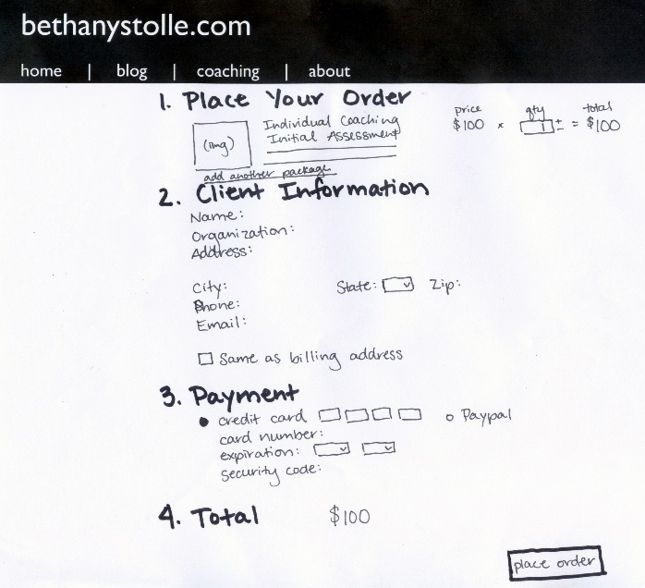
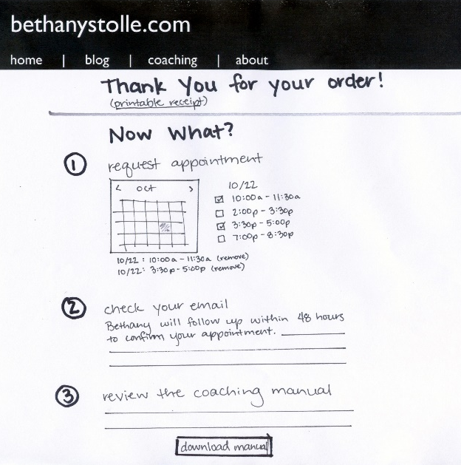
Digital Prototyping
v
Sketches
Checkout Flow | BethanyStolle
v
v
Notes:
12

Slide 13
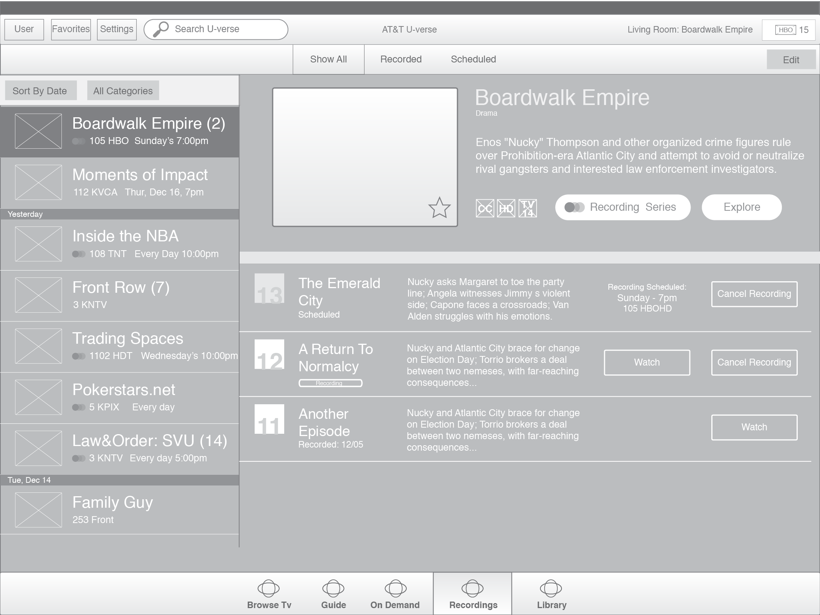
Digital Prototyping
v
Wireframe
AT&T | U-verse for Tablet
Notes:
13

Slide 14
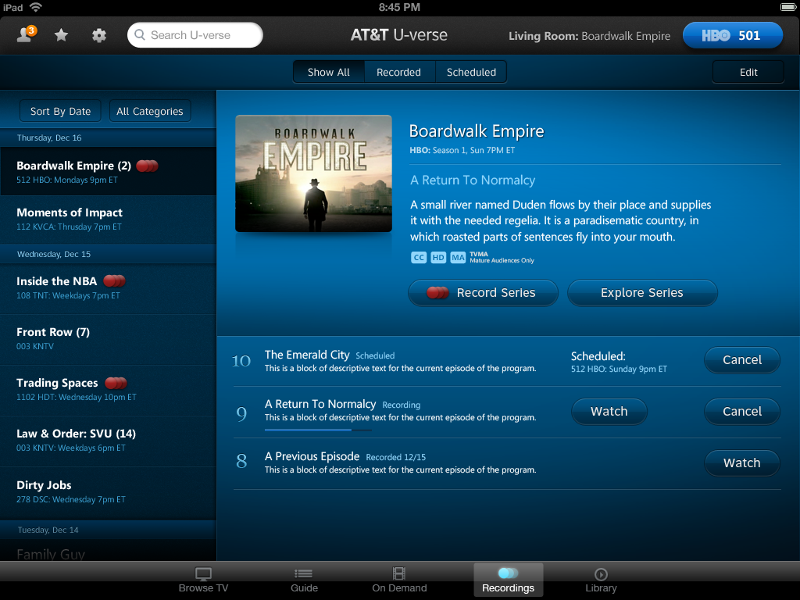
Digital Prototyping
v
Comp
AT&T | U-verse for Tablet
Notes:
14

Slide 15
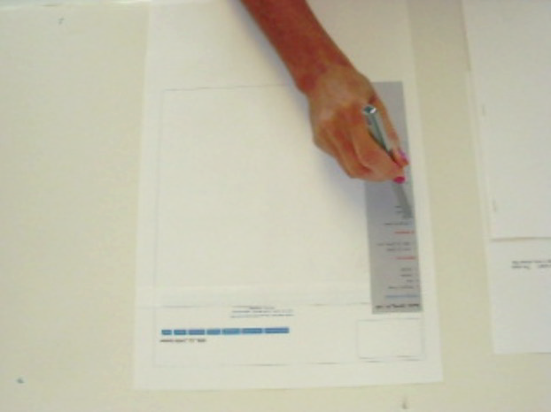
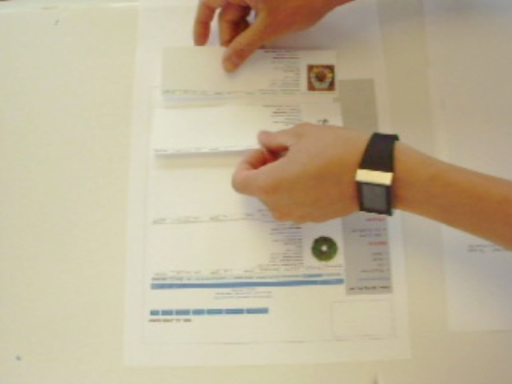
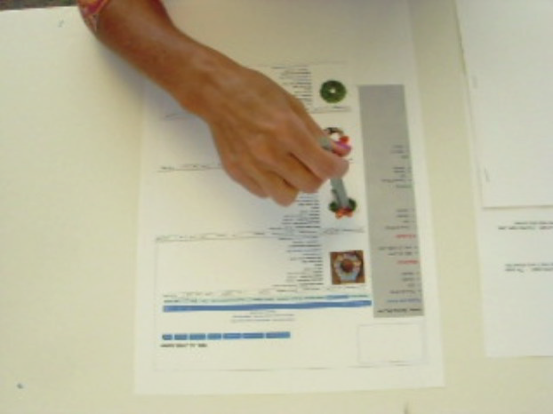
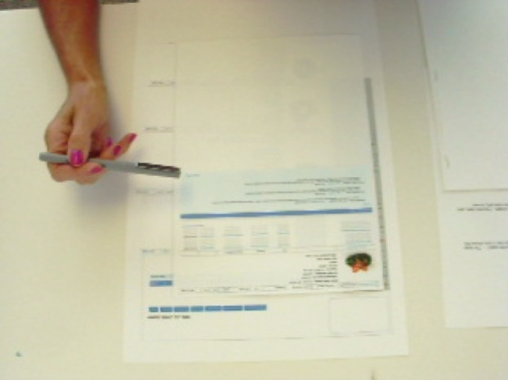
Digital Prototyping
v
Paper Prototyping
Task: Access the product details of product #1431 and confirm the vendor’s material selection.
Target | Internal PLM
Step 1
User is on the Dept home page
User “clicks” product category
Step 2
Product category is displayed
Step 3
User “clicks” a product to see the product details page
Step 4
The product details page is displayed. The user confirms the vendor’s material selection.
Notes:
15

Slide 16
Digital Prototyping
AESTHETICS
Digital
Prototype
Click-able
Comp
Simulation
Paper
Prototype
(Comp)
Archetype
Screen
(Comp)
Click-able
Wireframe
Paper
Prototype
(Wireframe)
Archetype
Screen
(Wireframe)
Low Fidelity Prototypes:
Allow for rapid iteration & “on the fly” customization
Sketching
v
Digital Prototypes
FUNCTIONALITY
Notes:
16

Slide 17
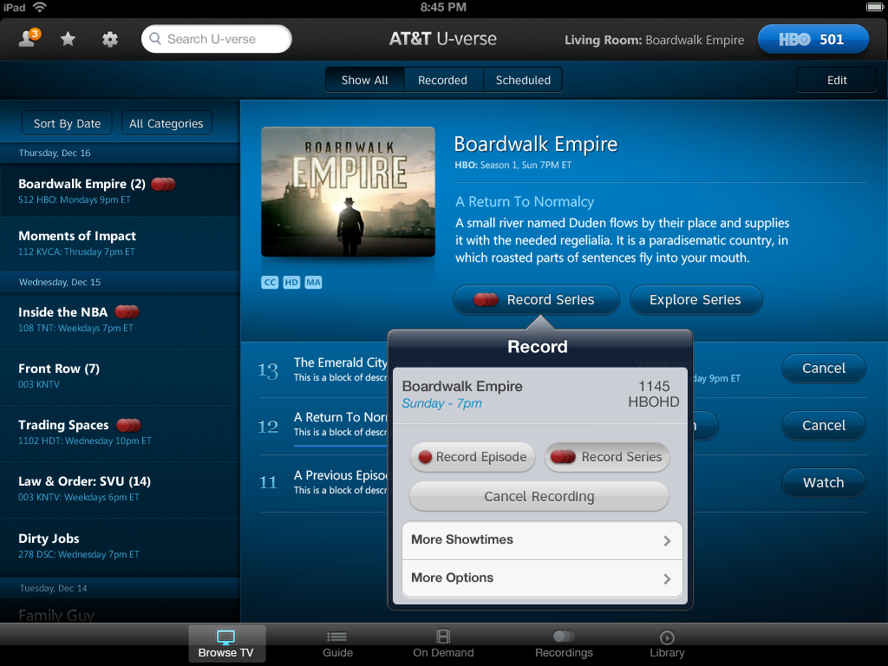
Digital Prototyping
v
Click-able Comp
Notes:
17

Slide 18
Digital Prototyping
v
Click-able Comp
Notes:
18

Slide 19
Digital Prototyping
AESTHETICS
Digital
Prototype
Click-able
Comp
Simulation
Paper
Prototype
(Comp)
Archetype
Screen
(Comp)
Click-able
Wireframe
Paper
Prototype
(Wireframe)
Archetype
Screen
(Wireframe)
Medium Fidelity Prototypes:
Allow for rich interactive experiences without the overhead of production code.
Sketching
v
Digital Prototypes
FUNCTIONALITY
Notes:
19

Slide 20
Digital Prototyping
AESTHETICS
Digital
Prototype
Click-able
Comp
Simulation
Paper
Prototype
(Comp)
Archetype
Screen
(Comp)
Click-able
Wireframe
Paper
Prototype
(Wireframe)
Archetype
Screen
(Wireframe)
Higher Fidelity = Decreased speed of Iteration
Sketching
v
Digital Prototypes
FUNCTIONALITY
Notes:
20

Slide 21
Physical Prototyping
AESTHETICS
Aesthetic
Model
High Fidelity
Functional
Prototype
Form
Model
Functional
Mockup
Ergonomic
Model
Functional
Proof of Concept
Sketching
v
Physical Prototypes
FUNCTIONALITY
Notes:
21

Slide 22
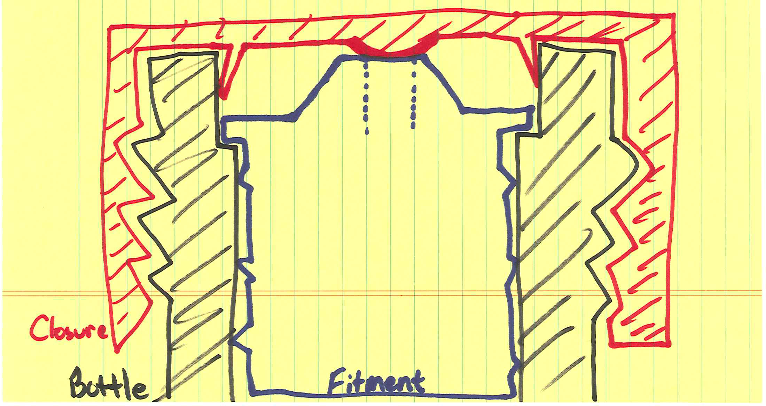
Physical Prototypes
v
Engineering Sketches
Notes:
22

Slide 23
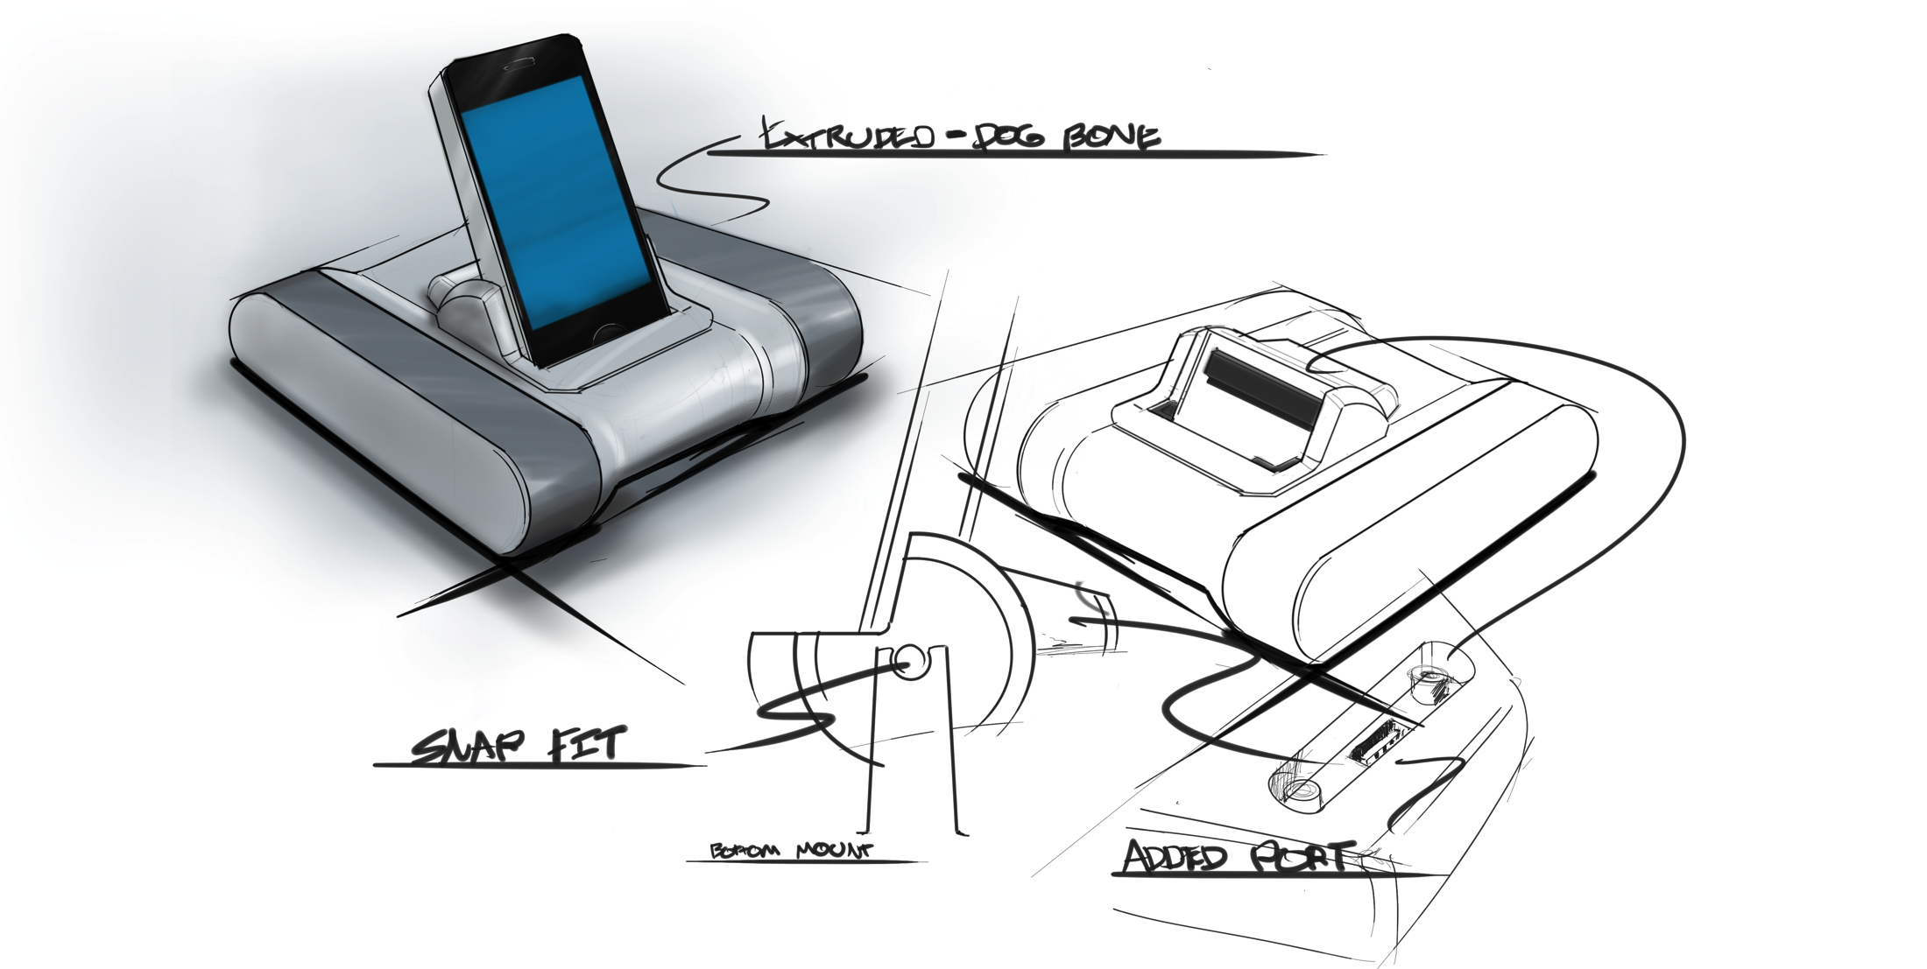
Physical Prototypes
v
Function Sketches
Notes:
23

Slide 24
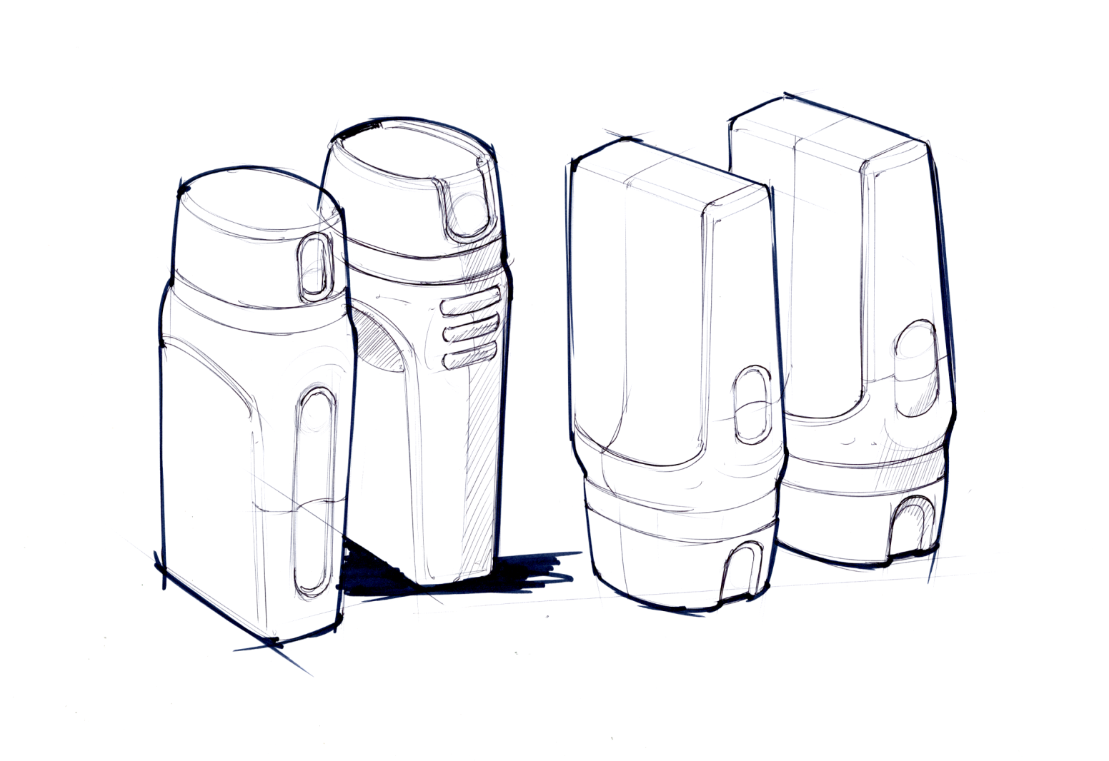
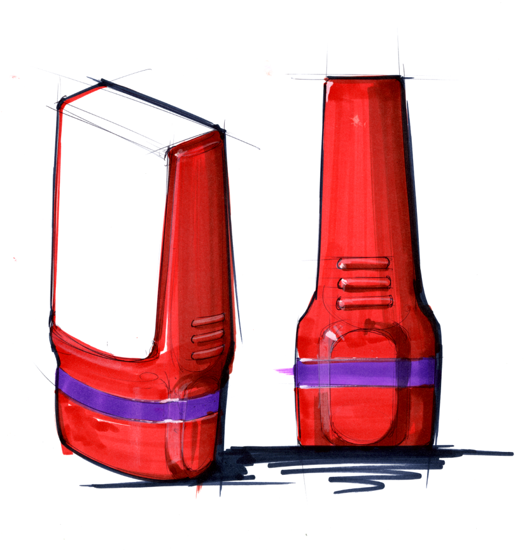
Physical Prototyping
v
Form Sketches
Notes:
24

Slide 25
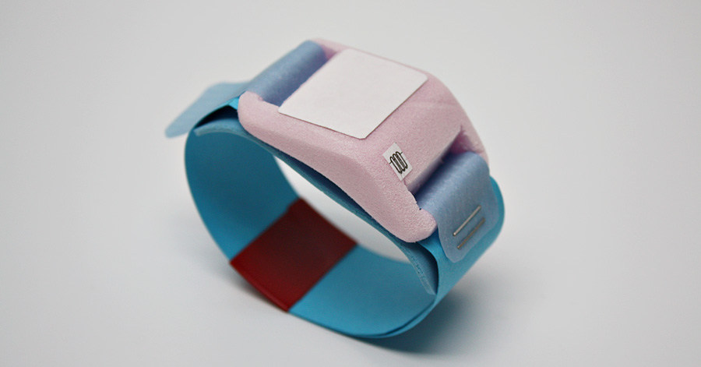
Physical Prototypes
v
Form / Ergonomic Model
Foam, paper & staples | LiLeger Inc.
Notes:
25

Slide 26
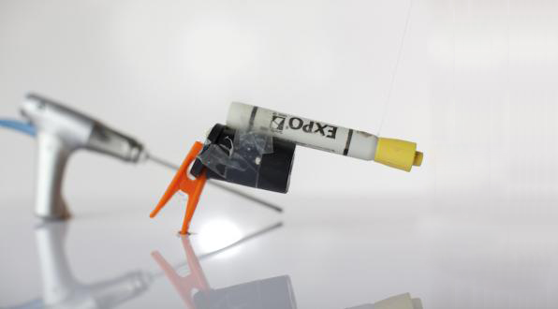
Physical Prototypes
v
Ergonomic Model
Otolaryngology Tool : IDEO
Chip clip, film canister, expo marker | IDEO
Notes:
26

Slide 27
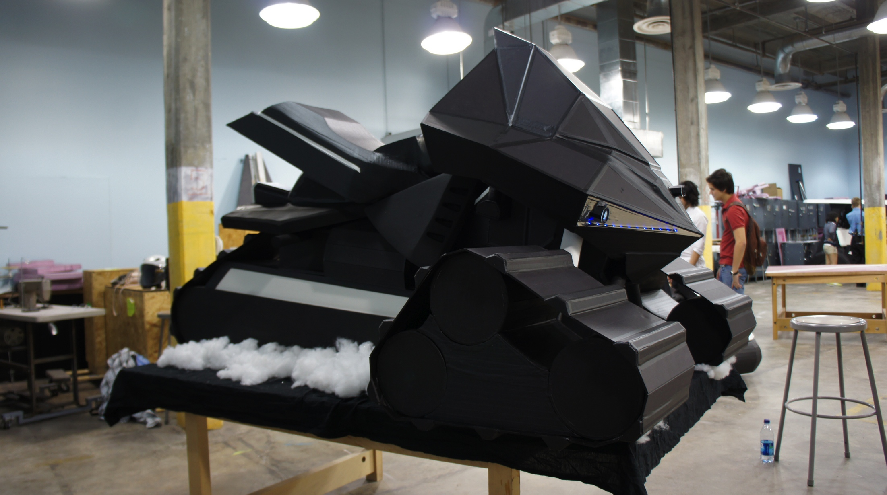
Physical Prototypes
v
Form Model
Foam core & Masking Tape | SCAD
Notes:
27

Slide 28
Physical Prototyping
AESTHETICS
Aesthetic
Model
High Fidelity
Functional
Prototype
Low Fidelity Prototypes:
Allow for rapid iteration
& “on the fly” customization
Form
Model
Functional
Mockup
Ergonomic
Model
Functional
Proof of Concept
Sketching
v
Physical Prototypes
FUNCTIONALITY
Notes:
28

Slide 29
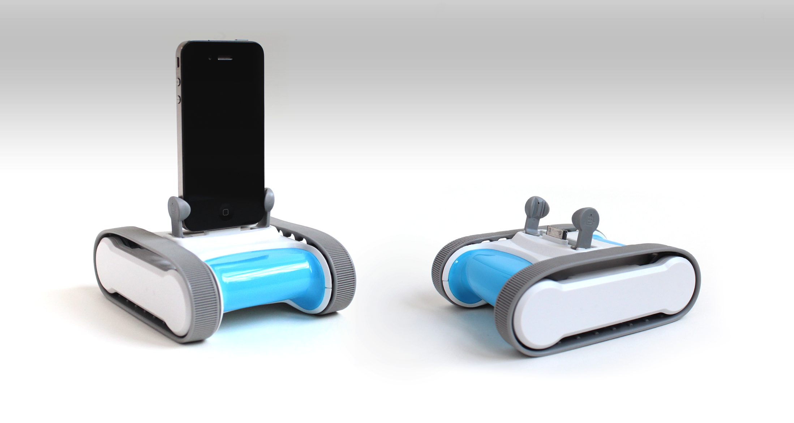
Physical Prototypes
v
Aesthetic Model
Romo – Personal Robot | Romotive
Notes:
29

Slide 30
Physical Prototyping
AESTHETICS
Aesthetic
Model
High Fidelity
Functional
Prototype
Medium Fidelity Prototypes:
Allow for rich interactive experiences without the overhead of manufacturing
Form
Model
Functional
Mockup
Ergonomic
Model
Functional
Proof of Concept
Sketching
v
Physical Prototypes
FUNCTIONALITY
Notes:
30

Slide 31
Physical Prototyping
AESTHETICS
Aesthetic
Model
High Fidelity
Functional
Prototype
Form
Model
Functional
Mockup
Higher Fidelity = Decreased speed of Iteration
Ergonomic
Model
Functional
Proof of Concept
Sketching
v
Digital Prototypes
FUNCTIONALITY
Notes:
31

Slide 32
What is the appropriate level of fidelity?
The level of fidelity that allows you to test what’s important while maximizing the number of possible iterations.
With most prototypes, the level of fidelity can be relatively low. People are naturally good at using their imagination to fill in the details.
Notes:
32

Slide 33
Start with Low Fidelity Prototypes
These prototypes are extremely useful as they can be made quickly, changed without repercussions, and often elicit better feedback (users are not worried about hurting the designers’ feelings).
Notes:
33

Slide 34
Creating Physical Prototypes
Who you are solving a problem for?
Who is the primary user of the product, system or service?
Does this person have any physical or cognitive disabilities?
What is the context of use for the product (where is the user when they are using this product? Does the use only happen in certain circumstances?)
Is there another primary, or secondary actor?
For Example:
Drone Pilot
Might need to accomplish familiar tasks while using a new set of controls.
Has a limited viewing screen for all sight lines and forms of system feedback.
Elderly Person
Might not be able to see font under 16pt
Or do any task requiring manual dexterity

Slide 35
Creating Physical Prototypes
What goal is the user trying to accomplish?
Use cases are a great place to start when outlining the user’s goal. Write a statement that captures the user’s goal, the context of use, and any associated constraints or considerations.
For Example:
Drone Pilot
Needs to be able to locate targets through the camera, maintain visual contact with targets while engaging, and keep control of the aircraft.
Elderly Person
Needs to locate their medication within a shared box of medication, confirm it’s the right one, and then take the pill – all without getting their glasses.

Slide 36
Creating Physical Prototypes
Loosely sketch a variety of forms, control surfaces, etc. that would allow the user to accomplish their goal. Try to come up with 2 – 3 different versions of the same thing, such that performing the task with each version will be noticeably different.
Start with overarching concepts – like form, visual differentiator, or control placement – and then add a few details. If your goal requires a sequence of actions, try to sketch these in as limited sequence as possible. Refer to your storyboards for the appropriate sequence.

Slide 37
Creating Physical Prototypes
Using low fidelity materials, create a prototype of each of your sketches that will allow users to accomplish the task. Note: you may also need to construct part of the “context of use” out of these materials as well.
Start with creating primary shapes with common materials – Cardboard, foam core & hot glue.
For form studies, use pink insulation foam from home depot (spray adhesive can be used to hold layers together. Use a rasp and sand paper to carve the form).
For screens / interfaces, use paper print outs – Multiple print outs can be used if the user needs to interact with the system.

Slide 38
Creating Physical Prototypes
Using low fidelity materials, create a prototype of each of your sketches that will allow users to accomplish the task. Note: you may also need to construct part of the “context of use” out of these materials as well.
For Example:
Drone Pilot
Needs to be able to locate targets through the camera, maintain visual contact with targets while engaging, and keep control of the aircraft.
Build:
Some form of cockpit – with Velcro stickers (allows user to move controls around as needed)
Primary controls – Cardboard tubes?
A panel with the appropriate secondary controls
A print out of the screen(s) that they might see as they complete the task
Elderly Person
Needs to locate their “Every 2 hour” medication within a shared box of medication, confirm it’s the right Rx, and then take the pill – all without getting their glasses.
Build
2-3 foam shapes that test the best shape for gripping – use a rasp and pink foam
2 – 3 Rx Labels for each foam shape to test the placement of Prescription information - with varying size fonts
Hick’s law*

Slide 39
Hicks’ law
With every additional choice, the time it will take for one to make a selection increases.
When prototyping products, systems, and services, Less = More. Try to prototype the variables that need the most attention or are vital to the user achieving their goal.
Notes:
39

Slide 40
Creating Physical Prototypes
Test your prototypes with 2 or 3 users in the context of use (or as close to it as possible):
Ask the user to imagine that they are in the appropriate context (in the bathroom taking medication, or in the cockpit of an airplane).
Tell they user they are going to be completing a familiar task with your prototype – tell them the task.
Provide the prototype, and the task on a piece of paper, and ask them to walk you through the act of performing it.

Slide 41
Creating Physical Prototypes
While Testing:
RECORD EVERYTHING – with more than one recording device (video or audio, and camera)
Have one person dedicated to taking notes and one person dedicated to taking photos or video.
Ask the user to talk as much as possible while performing the task

Slide 42
After Testing
Review your notes, video, and audio – capture each point of failure, for each user, on a post-it.
Failure: If they expressed surprise, made a design suggestion, or anything else that prevented them from completing the task).
User 1
User 2
User 3
Notes:
42

Slide 43
After Testing
Organize these post-its into groups or themes, where themes represent a set of failures that have something in common.
Notes:
43

Slide 44
After Testing
Using a different color post-it, label the theme for each group.
Notes:
44

Slide 45
After Testing
Refine your designs and prototypes so that they “solve” the problem. Repeat the process until they actually do.
Notes:
45

